Slide 1

DAYANANDA SAGAR UNIVERSITY
SCHOOL OF ENGINEERING
Department of Computer Science and Technology
Major Project Phase-II
SMART TRAFFIC MANAGEMENT SYSTEM FOR EMERGENCY VEHICLES
Team No : 4
Under the Supervision
Prof. Bharathy Vijayan
Presented By:
B Sri Sharan - ENG20CS0051
Sandeep Kumar Pradhan – ENG20CS0315
Uday Kumar A - ENG20CS0389
Vinod V - ENG20CS0413
Notes:
Title of the project
CSE Dept., SET-Jain University

Slide 2
Overview
Abstract
Problem Statement
Introduction
Social Impact
State of the Art work
Design
Methodology
Implementation
References
Dept of CSE., SOE-Dayananda Sagar University
<number> of 12

Slide 3
Abstract
Addressing challenges in emergency vehicle navigation through congested traffic.
Enhancing response times and overall efficiency of emergency services.
Implement a Smart Traffic Management System utilizing IoT technology.
Prioritize and facilitate the smooth movement of emergency vehicles.
Integrating IoT devices in vehicles and traffic infrastructure.
Real-time data exchange for dynamic traffic rerouting based on emergency priorities.
Reduction in emergency response times.
Improved traffic flow management during emergencies.
Enhanced overall safety and efficiency in emergency services.
Dept of CSE., SOE-Dayananda Sagar University
<number> of 12

Slide 4
Problem Statement
Traffic signals in India has a fixed time period to switch the signals. No changes for emergency vehicles in case of unavailability of traffic policemen. There is no traffic control unit in ambulance. Whenever ambulance reaches a certain junction with a traffic signal, it has to wait for several minutes until clearance.
Solution: "SMART TRAFFIC MANAGEMENT FOR EMERGENCY VEHICLES will streamline emergency vehicle passage through dynamically adjusting traffic signals, reducing response times, and ensuring efficient allocation of emergency services."
Dept of CSE., SOE-Dayananda Sagar University
<number> of 12

Slide 5
Introduction
In today's fast-paced world, efficient traffic management is crucial to ensure the safety and well-being of both the general public and emergency service providers.
The advent of Smart Traffic Management for Emergency Vehicles represents a significant leap forward in harnessing technology to address this challenge.
This innovative approach aims to streamline the movement of emergency vehicles through urban and suburban landscapes, enabling them to navigate through traffic with minimal delays.
By integrating real-time data and communication systems, Smart Traffic Management for Emergency Vehicles promises to revolutionize how emergency services respond to critical situations, potentially saving lives and reducing the impact of emergencies on our communities.
Dept of CSE., SOE-Dayananda Sagar University
<number> of 12

Slide 6
The project addresses the challenge of delayed emergency response due to traffic congestion
We will design and implement a sensor network that gathered information of the emergency vehicles. An intelligent control system will analyze this data and adjust traffic signals to prioritize emergency vehicles.
These devices will communicate with a central control system that uses algorithms to make quick decisions about changing traffic lights.
Our system will significantly reduce response times for emergency vehicles, enhancing overall emergency services and road safety.
Dept of CSE., SOE-Dayananda Sagar University

Slide 7
Social Impact
The project will save lives by ensuring faster access for emergency services, reducing the impact of critical medical situations on patients.
The implementation of IoT and sensor technologies will pave the way for more efficient and responsive traffic management systems.
Reduced Traffic Congestion: Smart traffic management for emergency vehicles can also alleviate traffic congestion. When traffic is directed to make way for ambulances, fire trucks or police cars.
Dept of CSE., SOE-Dayananda Sagar University
<number> of 12

Slide 8
State of the Art-work
Author’s Name/ Paper Title | Conference/Journal Name and year | Technology/ Design | Results shared by author | What you infer
Arihant Kamdar,Dr.Jigar kumar Shah | Smart Traffic System using Traffic flow models (2021) | YOLO algorithm for object detection and a Raspberry Pi micro-controller for implementation. | The experimental analysis section presents figures showing the relationship between traffic density, number of lanes, and time required for vehicles to pass, using different traffic flow models | Traffic light control system to prioritize ambulance movement through heavy traffic.
Shyam Shankaran R ,Logesh Rajendran | Real-Time Adaptive Traffic Control System For Smart Cities (2021) | openCV and Intelligent Transport System (ITS) Architecture | The results shared by the authors indicate that the proposed Adaptive Traffic Control System (ATCS) using image processing and OpenCV significantly reduces traffic congestion compared to traditional fixed-time traffic control systems and proposed ATCS framework, utilizing image processing and adaptive control algorithms, has the potential to enhance traffic control efficiency | The ATCS adapts traffic signal timings based on real-time traffic patterns, demonstrating its effectiveness in optimizing vehicle transit delays and improving overall traffic flow in a 4-way intersection and aims to dynamically adjust traffic signals and reduces congestion
Dept of CSE., SOE-Dayananda Sagar University
<number> of 12

Slide 9
Author’s Name/ Paper Title | Conference/Journal Name and year | Technology/ Design | Results shared by author | What you infer
Jiri Ruzicka, Kristyna Navratilova | Crisis management as the part of smart traffic control in cities (2020) | Telematics and Microsimulation (VISSIM) technologies | The system diverts traffic during emergencies, increasing safety and reducing delays. The study emphasizes the need for public awareness and gradual introduction of crisis management systems in cities. | The system aims to enhance safety, traffic flow, and reduce delays in emergencies. The research involves extending telematics technologies with crisis management functionalities
Dr. Vikram Bali, Ms. Sonali Mathur , Dr. Vishnu Sharma, Dev Gaur | Smart Traffic Management System using IoT Enabled Technology (2020) | IOT and RFID | The authors proposed an STMS based on IoT, utilizing RFID technology. The system creates "Green Corridors" for emergency vehicles, ensuring timely arrival at destinations and reducing the loss of human life. The authors compared their proposed system with manual traffic control and automatic systems. | The proposed STMS aims to reduce delays for emergency vehicles, potentially saving lives. The implementation involves an RFID tag on ambulances, RFID readers at traffic lights, and Arduino-based control
Dept of CSE., SOE-Dayananda Sagar University

Slide 10
Author’s Name/ Paper Title | Conference/Journal Name and year | Technology/ Design | Results shared by author | What you infer
Mahima Jaiswal,Neetu Gupta ,Ajay Rana | Real-time Traffic Management in Emergency using Artificial Intelligence (2020) | Artificial intelligence (AI) in traffic management. | It discusses the application of Artificial Intelligence (AI) in traffic management, the challenges faced in traffic systems, and proposes a design that includes variable signal timings, driver behavior modeling, recognition of unmanned vehicles, and a dedicated corridor for medical emergencies. | The role of Artificial Intelligence (AI) in traffic management, proposing a design that focuses on efficient lane management during medical emergencies
Dept of CSE., SOE-Dayananda Sagar University

Slide 11
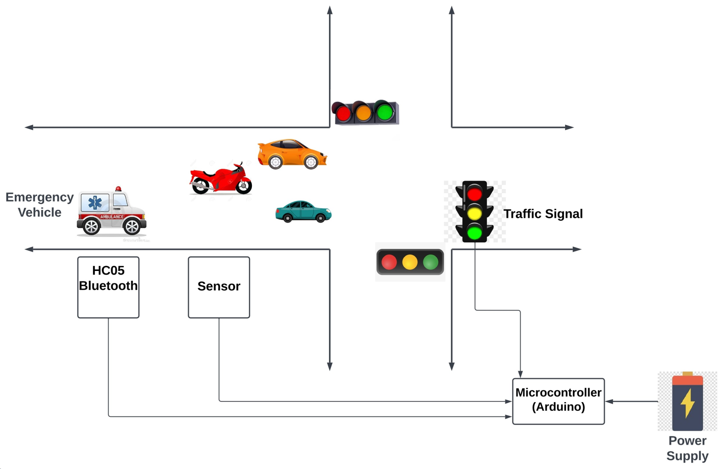
Design
11/6/2023
Dept of CSE., SOE-Dayananda Sagar University
<number> of 12

Slide 12
Methodology
Components:-
Arduino Board :
The Arduino act’s as the central control unit for the system. It will receive signals from the bluetooth module and ultrasonic sensors, process the data, and control the LED signal lights.
It has 3 Ports in total which are named as Port B, Port C and Port D.
1.Digital Pins (D0-D13):
  These pins can be used for both input and output.
  Pins D0 to D13 can be used as digital input or output.
2.Analog Pins (A0-A5):
  These pins can be used as analog inputs.
  They can also be used as digital inputs or outputs.
3.Power Pins:
  5V: Provides a regulated 5V supply.
  3.3V: Provides a regulated 3.3V supply.
  GND: Ground pins.

Slide 13
Ultrasonic Sensor
Operating Voltage:
Typically operates at 5V DC.
Measuring Range:
Commonly specified as 2 cm to 400 cm
Ultrasonic Frequency:
The sensor emits ultrasonic sound waves at a frequency of around 40 kHz.
Duration Measurement (pulseIn): The pulseIn function is used to measure the duration of the pulse on the echoPin. This duration represents the time taken for the ultrasonic pulse to travel to the object and back.
The code multiplies the duration by the speed of sound and divides by 2 to get the distance in centimeters.
Distance=Duration×0.0342
2

Slide 14
LED Signal Lights
  When the Arduino detects an approaching emergency vehicle through bluetooth module and ultrasonic sensors, it will change the signal lights to give the vehicle the right of way.
Bread Board
  Using a breadboard to create the necessary connections and interfaces between the components.
Connecting Wires
  We use jumper wires to connect the Bluetooth module, ultrasonic sensors, Arduino, LED lights and power supply.
Battery
  A 12V Battery to provide the power supply for the circuit system.
Dept of CSE., SOE-Dayananda Sagar University

Slide 15
The HC-05 is a popular Bluetooth module that you can use in Arduino projects to establish wireless communication with other devices, such as smartphones or tablets.
Operating Voltage:
The HC-05 module typically operates in the voltage range of 3.3V to 6V.
Frequency:
Operates at a frequency of 2.4GHz.
Read Distance:
The HC-05, have a range of about 10 meters (approximately 33 feet).

Slide 16
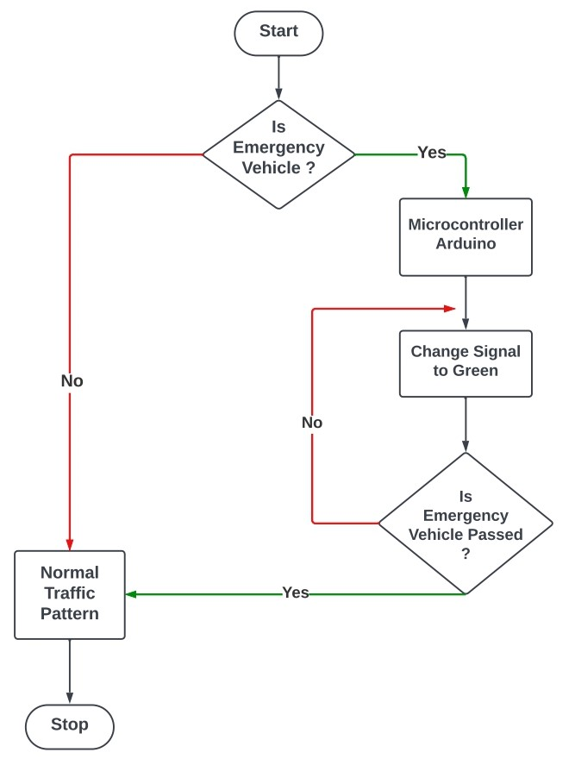
Implementation: Flowchart
Dept of CSE., SOE-Dayananda Sagar University

Slide 17
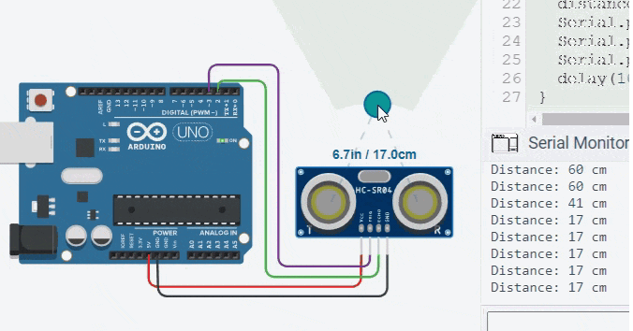
Simulation for ultrasonic sensor
Dept of CSE., SOE-Dayananda Sagar University

Slide 18
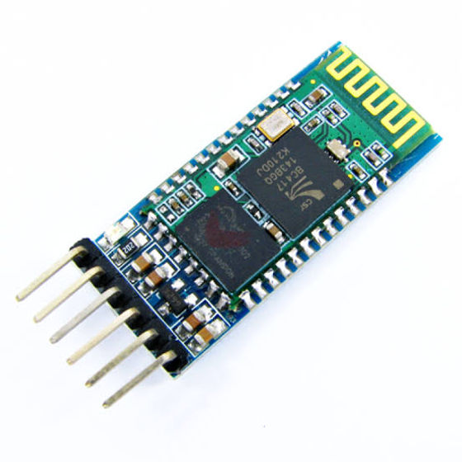
HC-05 Bluetooth Module
Dept of CSE., SOE-Dayananda Sagar University

Slide 19
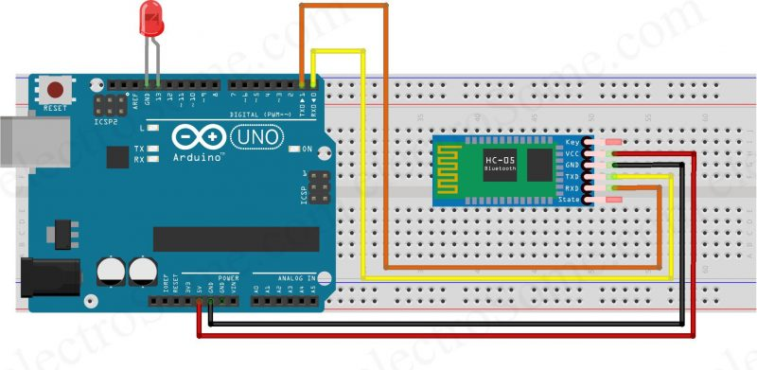
Simulation for Bluetooth Module
Dept of CSE., SOE-Dayananda Sagar University

Slide 20

Application
Dept of CSE., SOE-Dayananda Sagar University

Slide 21
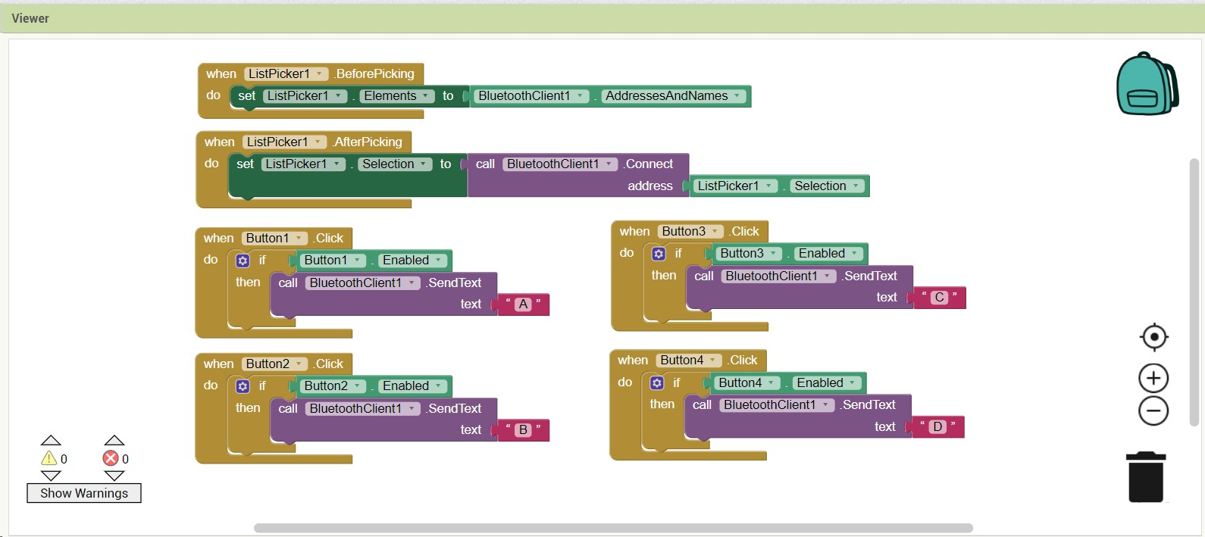
Dept of CSE., SOE-Dayananda Sagar University

Slide 22
References
D. Vikram, S. Mathur, V. Sharma, and D. Gaur, "Smart Traffic Management System using IoT Enabled Technology," in 2020 2nd International Conference on Advances in Computing, Communication Control and Networking (ICACCCN), Noida, UP, 2020, pp. 565-568. DOI: 10.1109/ICACCCN51052.2020.9362753.
S. S. R. and L. Rajendran, "Real-Time Adaptive Traffic Control System for Smart Cities," in 2021 International Conference on Computer Communication and Informatics (ICCCI), Coimbatore, India, Jan. 27–29, 2021, DOI: 10.1109/ICCCI50826.2021.9402597.
J. Ruzicka, K. Navratilova, and T. Tichy, "Crisis Traffic Management in the City Using Traffic Lights," in Smart Cities Symposium Prague 2020, 2020, pp. 134-139, doi: 10.1109/MOSATT48908.2019.8944093.
A. Kamdar and J. Shah, "Smart Traffic System using Traffic Flow Models," in Proceedings of the International Conference on Artificial Intelligence and Smart Systems (ICAIS-2021), 2021, pp. 465-471. DOI: 10.1109/ICAIS50930.2021.9396002.
Dept of CSE., SOE-Dayananda Sagar University
<number> of 12

Slide 23
THANK YOU
Dept of CSE., SOE-Dayananda Sagar University

